Slide 1
UPPER SIXTH ARTS
GEOGRAPHY
Lesson 14
Aid and Interdependence
Notes:
Good morning, class, and welcome to our geography lesson. I am your geography teacher, Mr Kamdem. Today we are starting Lesson 14: Aid and Interdependence.

Slide 2
CLASS INFO
Class, Chapter and Duration
Class | Upper Sixth Arts
Chapter | Module 7: Understanding and managing contemporary environmental and development issues
Duration | 2 periods (2 × 50 minutes)
Notes:
This lesson is for Upper Sixth Arts. It belongs to Module 7: Understanding and managing contemporary environmental and development issues. We shall need 2 periods to cover it.

Slide 3
IDENTIFICATION
Lesson Identification
Topic | Current Development Issues
Sub-topic | Trade and Cooperation
Lesson | Lesson 14: Aid and Interdependence
Notions / Concepts | Aid, bilateral aid, multilateral aid, NGO, tied aid, interdependence.
Syllabus focus | Meaning of foreign aid; types (official, voluntary, direct, indirect); donors and recipients; appraisal (arguments for and against).
Competence | Learners are able to classify aid and evaluate its effects.
Notes:
Our topic is Current Development Issues, and the sub-topic is Trade and Cooperation. The key notions we shall use today are: aid, bilateral aid, multilateral aid, NGO, tied aid, interdependence. At the end, you should be able to do this: learners are able to classify aid and evaluate its effects.

Slide 4

HOMEWORK CORRECTION
Correction of the Homework
Question (Lesson 13: Recent Developments in Global Trade):
Compare the price of a bag of cocoa and a bag of cement over five years.
Notes:
Before we start the new lesson, let us correct the homework I gave you at the end of Lesson 13: Recent Developments in Global Trade. The question was: Compare the price of a bag of cocoa and a bag of cement over five years. Take out your exercise books.

Slide 5
HOMEWORK CORRECTION
Correction: Possible Answer
Example: cocoa may rise from about 1,000 to 1,500 F/kg and fall again, while a bag of cement rises steadily from about 4,500 to 5,500 F. The farmer must sell more cocoa to buy the same cement: the terms of trade worsen.
Notes:
Here is a good answer. Example: cocoa may rise from about 1,000 to 1,500 F/kg and fall again, while a bag of cement rises steadily from about 4,500 to 5,500 F. The farmer must sell more cocoa to buy the same cement: the terms of trade worsen. Compare it with your own answer and correct your work in red.

Slide 6
LESSON PLAN
Lesson Plan
Correction of the homework
Objectives and recall
Real-life situation and action to take
Learning activities
Board summary
Evaluation, remediation and homework
Notes:
Here is the plan of our lesson today. First, we shall correct the homework. Then we shall look at the objectives and recall what you already know. After that, we shall study a situation from real life and the action to take, and do the learning activities. Finally, we shall copy the board summary, do the evaluation and the remediation, and I will give you the homework.

Slide 7
OBJECTIVES
Objectives
By the end of this lesson, you should be able to:
Define aid and classify its types.
Identify donors and recipients.
Evaluate arguments for and against aid.
Notes:
By the end of this lesson, you should be able to do three things. Number 1: define aid and classify its types. Number 2: identify donors and recipients. Number 3: evaluate arguments for and against aid.

Slide 8
PREVIOUS KNOWLEDGE
Previous Knowledge
Some schools and wells were built with foreign help.
Countries depend on each other.
Notes:
Let us first remember what you already know. Some schools and wells were built with foreign help. Countries depend on each other. Keep this in mind, because we shall build on it today.

Slide 9
REAL-LIFE SITUATION
Situation in Real Life
A village in the Far North receives a water pump from an NGO and food aid after a drought. But some people say aid makes the country dependent and does not reach the poor.
Notes:
Listen carefully to this situation from real life. A village in the Far North receives a water pump from an NGO and food aid after a drought. But some people say aid makes the country dependent and does not reach the poor. Think about it, because I am going to ask you some questions.

Slide 10
REAL-LIFE SITUATION
Situation: Question 1
What is the problem in the situation?
Notes:
Question 1: What is the problem in the situation? Think for a moment, then raise your hand to answer.

Slide 11
REAL-LIFE SITUATION
Answer
Aid helps but is also criticised.
Notes:
Good. Aid helps but is also criticised.

Slide 12
REAL-LIFE SITUATION
Situation: Question 2
Give two types of aid in the situation.
Notes:
Question 2: Give two types of aid in the situation. Think for a moment, then raise your hand to answer.

Slide 13
REAL-LIFE SITUATION
Answer
A water pump (development aid) and food aid (emergency aid).
Notes:
Good. A water pump (development aid) and food aid (emergency aid).

Slide 14
REAL-LIFE SITUATION
Situation: Question 3
Give one criticism.
Notes:
Question 3: Give one criticism. Think for a moment, then raise your hand to answer.

Slide 15
REAL-LIFE SITUATION
Possible Answer
It creates dependence.
Notes:
Good. It creates dependence.

Slide 16
ACTION TO TAKE
Action to Take
Use aid projects well and aim for self-reliance.
Notes:
From this situation, the action we are working towards in this lesson is the following: use aid projects well and aim for self-reliance.

Slide 17
JUSTIFICATION
Justification of the Lesson
This lesson helps us to judge the role of aid in development.
Notes:
Why is this lesson important for you? This lesson helps us to judge the role of aid in development.

Slide 18
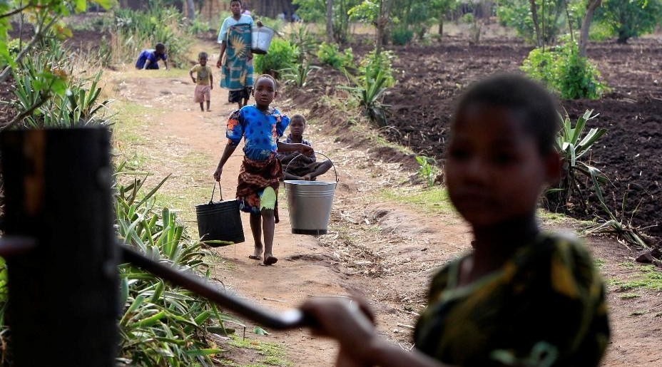
1. MEANING OF AID
Activity 1
A village water pump.
Notes:
Activity 1. Look carefully at this picture: a village water pump. Observe every detail before I ask the question.

Slide 19
1. MEANING OF AID
Activity 1: Question
What is foreign aid?
Notes:
Here is the question for Activity 1: What is foreign aid? Take one minute to think and write your answer in your rough notebook.

Slide 20
1. MEANING OF AID
Activity 1: Answer
Help in money, goods or skills given by one country or organisation to another.
Notes:
Let us check the answer together. Help in money, goods or skills given by one country or organisation to another.

Slide 21
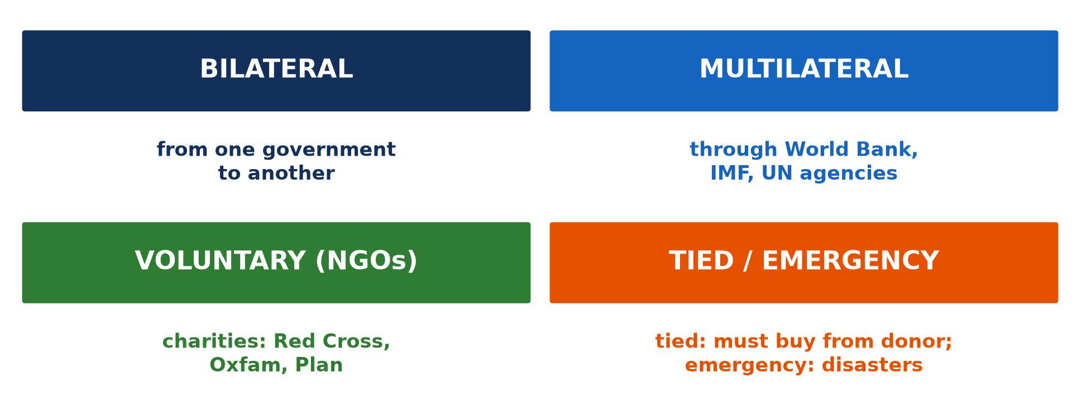
2. TYPES OF AID
Activity 2
Types of aid.
Notes:
Activity 2. Look carefully at this diagram: types of aid. Observe every detail before I ask the question.

Slide 22
2. TYPES OF AID
Activity 2: Question
Distinguish bilateral and multilateral aid.
Notes:
Here is the question for Activity 2: Distinguish bilateral and multilateral aid. Take one minute to think and write your answer in your rough notebook.

Slide 23
2. TYPES OF AID
Activity 2: Answer
Bilateral: government to government. Multilateral: through the World Bank, IMF or UN.
Notes:
Let us check the answer together. Bilateral: government to government. Multilateral: through the World Bank, IMF or UN.

Slide 24

2. EMERGENCY AID
Activity 3
Food aid being unloaded.
Notes:
Activity 3. Look carefully at this picture: food aid being unloaded. Observe every detail before I ask the question.

Slide 25
2. EMERGENCY AID
Activity 3: Question
When is emergency aid given?
Notes:
Here is the question for Activity 3: When is emergency aid given? Take one minute to think and write your answer in your rough notebook.

Slide 26
2. EMERGENCY AID
Activity 3: Answer
After disasters like droughts, floods or wars.
Notes:
Let us check the answer together. After disasters like droughts, floods or wars.

Slide 27
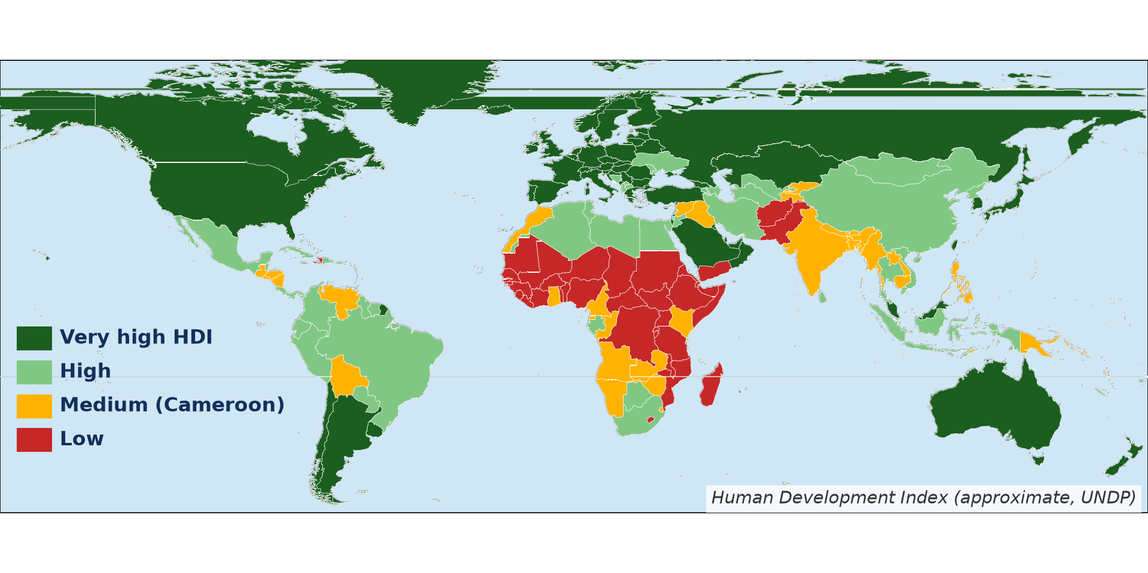
3. DONORS AND RECIPIENTS
Activity 4
Rich and poor countries (approximate HDI).
Notes:
Activity 4. Look carefully at this diagram: rich and poor countries (approximate HDI). Observe every detail before I ask the question.

Slide 28
3. DONORS AND RECIPIENTS
Activity 4: Question
Name two donors and two recipient regions.
Notes:
Here is the question for Activity 4: Name two donors and two recipient regions. Take one minute to think and write your answer in your rough notebook.

Slide 29
3. DONORS AND RECIPIENTS
Activity 4: Answer
Donors: USA, EU countries (also Japan, China). Recipients: Sub-Saharan Africa, South Asia.
Notes:
Let us check the answer together. Donors: USA, EU countries (also Japan, China). Recipients: Sub-Saharan Africa, South Asia.

Slide 30
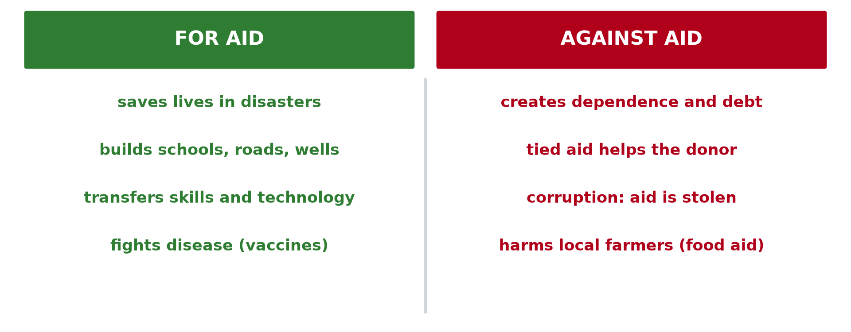
4. APPRAISAL OF AID
Activity 5
Arguments for and against aid.
Notes:
Activity 5. Look carefully at this diagram: arguments for and against aid. Observe every detail before I ask the question.

Slide 31
4. APPRAISAL OF AID
Activity 5: Question
Give two arguments for and two against aid.
Notes:
Here is the question for Activity 5: Give two arguments for and two against aid. Take one minute to think and write your answer in your rough notebook.

Slide 32
4. APPRAISAL OF AID
Activity 5: Answer
For: saves lives, builds schools. Against: dependence, corruption.
Notes:
Let us check the answer together. For: saves lives, builds schools. Against: dependence, corruption.

Slide 33
BOARD SUMMARY
Board Summary
Topic: Current Development Issues
Sub-topic: Trade and Cooperation
Lesson 14: Aid and Interdependence
Notes:
Now we are going to copy the board summary. Write the title and the headings neatly in your notebooks. I will give you enough time for each slide, so do not rush.

Slide 34
BOARD SUMMARY
1. Meaning of Foreign Aid
Foreign aid can be defined as follows:
Aid: It is help in money, goods or skills given to a country or people in need. It can be a gift or a loan at low interest.
Notes:
Let us copy Meaning of Foreign Aid. Foreign aid can be defined as follows. On this slide we have Aid. Write each point on a new line, with the key term first, and explain it in your own words when we revise. When you finish, we go to the next slide.

Slide 35
BOARD SUMMARY
1. Meaning of Foreign Aid (continued)
Interdependence: It is the dependence of countries on one another. Donors gain markets, raw materials and influence, while recipients gain money and skills.
Notes:
We continue with Meaning of Foreign Aid. On this slide we have Interdependence. Write each point on a new line, with the key term first, and explain it in your own words when we revise.

Slide 36
BOARD SUMMARY
2. Types of Aid
Aid is of the following types:
Official aid: Bilateral aid goes from one government to another. Multilateral aid goes through bodies like the World Bank or the UN.
Notes:
Let us copy Types of Aid. Aid is of the following types. On this slide we have Official aid. Write each point on a new line, with the key term first, and explain it in your own words when we revise. When you finish, we go to the next slide.

Slide 37
BOARD SUMMARY
2. Types of Aid (continued)
Voluntary aid: It is given by NGOs and charities such as the Red Cross or Plan International. It often funds small local projects.
Notes:
We continue with Types of Aid. On this slide we have Voluntary aid. Write each point on a new line, with the key term first, and explain it in your own words when we revise. When you finish, we go to the next slide.

Slide 38
BOARD SUMMARY
2. Types of Aid (continued)
Direct and indirect aid: Direct aid goes straight to the project, such as food, wells or schools. Indirect aid passes through loans, debt relief or trade advantages; tied aid must be spent on the donor's goods.
Notes:
We continue with Types of Aid. On this slide we have Direct and indirect aid. Write each point on a new line, with the key term first, and explain it in your own words when we revise.

Slide 39
BOARD SUMMARY
2. Types of Aid
Illustration: types of aid
Notes:
Now draw this illustration in your notebook: types of aid. Give it a title and label it clearly.

Slide 40
BOARD SUMMARY
3. Donors and Recipients
Aid flows from donors to recipients as follows:
Donors: The USA, the EU countries, Japan and China are the main donors. The World Bank, the IMF and the UN agencies also give aid.
Notes:
Let us copy Donors and Recipients. Aid flows from donors to recipients as follows. On this slide we have Donors. Write each point on a new line, with the key term first, and explain it in your own words when we revise. When you finish, we go to the next slide.

Slide 41
BOARD SUMMARY
3. Donors and Recipients (continued)
Recipients: Most aid goes to sub-Saharan Africa and South Asia. Countries in crisis receive emergency aid after wars, floods or droughts.
Notes:
We continue with Donors and Recipients. On this slide we have Recipients. Write each point on a new line, with the key term first, and explain it in your own words when we revise.

Slide 42
BOARD SUMMARY
4. Appraisal of Aid
Aid has arguments for and against:
Arguments for aid: Aid saves lives in disasters and builds schools, clinics and wells. It transfers skills and technology.
Notes:
Let us copy Appraisal of Aid. Aid has arguments for and against. On this slide we have Arguments for aid. Write each point on a new line, with the key term first, and explain it in your own words when we revise. When you finish, we go to the next slide.

Slide 43
BOARD SUMMARY
4. Appraisal of Aid (continued)
Arguments against aid: Aid can create dependence and debt, and some is lost to corruption. Tied aid benefits the donor more than the recipient.
Notes:
We continue with Appraisal of Aid. On this slide we have Arguments against aid. Write each point on a new line, with the key term first, and explain it in your own words when we revise.

Slide 44
BOARD SUMMARY
4. Appraisal of Aid
Illustration: arguments for and against aid
Notes:
Now draw this illustration in your notebook: arguments for and against aid. Give it a title and label it clearly.

Slide 45
FORMATIVE EVALUATION
Evaluation 1
Give three types of aid with examples.
Notes:
Now let us check what you have understood. Question 1: Give three types of aid with examples. Answer in your exercise book.

Slide 46
FORMATIVE EVALUATION
Expected Answer
Bilateral (France to Cameroon), multilateral (World Bank), voluntary (Red Cross).
Notes:
The expected answer is: bilateral (France to Cameroon), multilateral (World Bank), voluntary (Red Cross). If you got it right, well done.

Slide 47
FORMATIVE EVALUATION
Evaluation 2
Give two advantages and two disadvantages of aid.
Notes:
Now let us check what you have understood. Question 2: Give two advantages and two disadvantages of aid. Answer in your exercise book.

Slide 48
FORMATIVE EVALUATION
Expected Answer
Advantages: saves lives, builds services. Disadvantages: dependence, corruption.
Notes:
The expected answer is: advantages: saves lives, builds services. Disadvantages: dependence, corruption. If you got it right, well done.

Slide 49
REMEDIATION
Remediation
Fill in the blanks:
Aid between two governments is ______.
Charities are ______.
Aid spent in the donor country is ______ aid.
Notes:
For those who need more practice, fill in the blanks in your exercise book. The answers are: number 1, bilateral; number 2, NGOs; number 3, tied.

Slide 50
HOMEWORK
Homework
Find an aid project in your region and write who funds it and what it does.
Notes:
For your homework: Find an aid project in your region and write who funds it and what it does. We shall correct it at the beginning of our next lesson.

Slide 51
NEXT LESSON
Next Lesson
Our next lesson will be on:
Further Study 1: Contrast in Development within Cameroon
Notes:
Our next lesson will be on Further Study 1: Contrast in Development within Cameroon. Thank you for your attention, and see you next time.

Slide 52
BILINGUAL GAME
Bilingual Game (Jeu Bilingue)
English | Français
Aid | L'aide
Donor | Le donateur
Loan | Le prêt
Debt | La dette
Charity | L'organisation caritative
Dependence | La dépendance
Notes:
Let us play the bilingual game. I say a word in English, and you give me the French word. Then we do the reverse.

Slide 53
LOGBOOK
Official Logbook (1/2)
Module / Topic | Current Development Issues
Lesson Title | Lesson 14: Aid and Interdependence
Expected Learning Outcomes | Define aid and classify its types. Identify donors and recipients. Evaluate arguments for and against aid.
Competence | Learners are able to classify aid and evaluate its effects.
Notes:
I record this information in the official logbook of the class after the lesson.

Slide 54
LOGBOOK
Official Logbook (2/2)
Matter Taught | Meaning of Foreign Aid; Types of Aid; Donors and Recipients; Appraisal of Aid.
Evaluation | Formative evaluation and remediation exercise.
Homework | Find an aid project in your region and write who funds it and what it does.
Enrolment / Present / Absent | ____ / ____ / ____
Achievement | To be completed after the lesson.
Notes:
I complete the second page of the logbook: the matter taught, the evaluation, the homework and the attendance.

Slide 55
TEACHER'S NOTE
Teacher's Note
Timing: Homework correction, plan, objectives 8 min | Recall, situation, action 10 min | 5 activities 30 min | Board summary (copying) 30 min | Evaluation, remediation 10 min | Homework, next lesson 5 min | Logbook 7 min
Without the projector (Activity 1): list aid projects near you.
Without the projector (Activity 2): read the boxes.
Without the projector (Activity 3): discuss food aid.
Without the projector (Activity 4): read the map.
Without the projector (Activity 5): debate in class.
Notes:
This slide is for me, the teacher: it gives the timing of the lesson and what to do if the projector is not available.

Slide 56
REFERENCES
References
National Geography Syllabus, MINESEC/IGE/IP-SS, 2019 — Module 7 (Environment and Development).
Photo, Activity 1: “Girls from the village of Mwachilolo head to the Pump Aid Elephant wat” by PumpAid, CC BY 2.0, via Flickr (https://www.flickr.com/photos/84463652@N06/8161357208)
Photo, Activity 3: “WFP food distribution” by UNAMID Photo, CC BY-NC-ND 2.0, via Flickr (https://www.flickr.com/photos/58538810@N03/12495227734)
Diagrams and animations: drawn for this lesson (Geography Department).
Notes:
These are the references and picture credits used to prepare this lesson.

